Slide 1
Source Code Control
Software that tracks changes to files
Stores all versions of files and their change records
Provides multiple developers access to files
Notes:
Source Code Control
Source code control software tracks changes to files. All versions of files are stored in a repository for later retrieval. Source code control provides multiple developers access to files and controls who has access to a file for editing. For larger, team-based projects, source code control is an essential element.

Slide 2
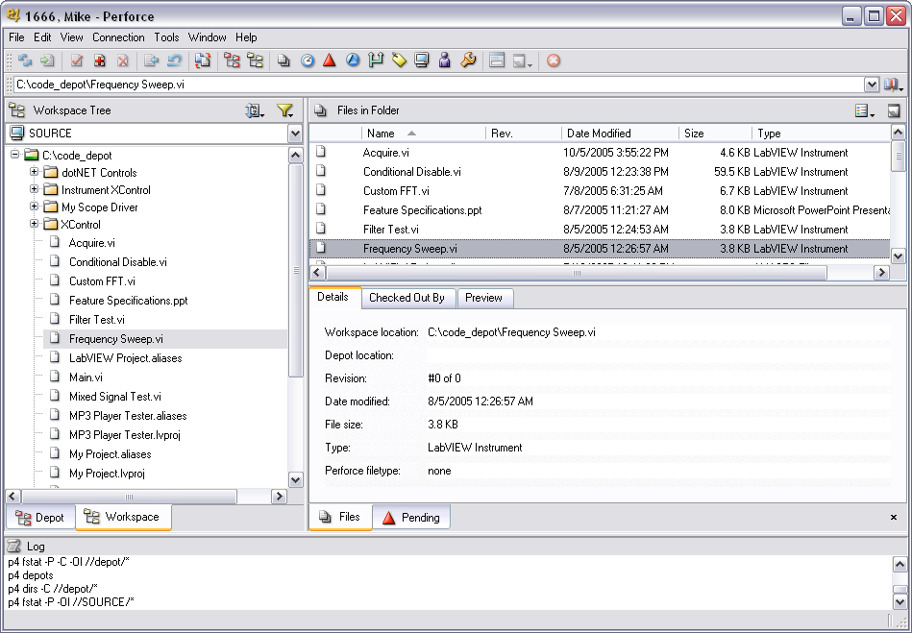
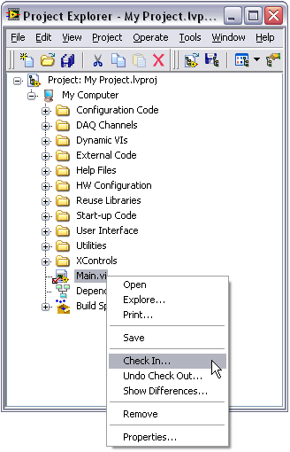
Source Code Control – Options
Use within LabVIEW Professional Development System
Use directly through a source code control tool
Notes:
Source Code Control – Options
Source code control is completely integrated with the LabVIEW Professional Development system. You can access source code control through the Project Explorer. You can access the functionality integrated in LabVIEW through the interface of the source code control provider. With the Project Explorer, you never have to leave the LabVIEW environment after you configure LabVIEW to use source code control.

Slide 3
Source Code Control – Integration with the LabVIEW Project
LabVIEW Project makes accessing SCC in LabVIEW simpler
Right-click one or more files to check in or out
Right-click and select Show Differences to view edits interactively (Perforce and VSS)
File icon shows current status
Checked in
Checked out
Notes:
Source Code Control – Integration with the LabVIEW Project
Use the Project Explorer to check a file into or out of the source code control system. You can also right-click a file and select Show Differences to view the differences between the item that is currently being edited and what is checked in at the head of the source code control system. The Project Explorer also shows the current status of the file, indicating if the file is checked in or checked out of the source code control system.

Slide 4
Source Code Control – Supported Packages
Perforce
Microsoft Visual SourceSafe
IBM Rational ClearCase
Serena Version Manager (PVCS)
Borland StarTeam
MKS Source Integrity
Subversion*
CVS*
Others compatible with Microsoft Visual Studio
* Requires low-cost third-party plug-in
Notes:
Source Code Control – Supported Packages
The following list of third-party source code control tools can integrate with LabVIEW:
Perforce
Microsoft Visual SourceSafe
IBM Rational ClearCase
Serena Version Manager (PVCS)
Borland Star Team
MKS Source Integrity
Subversion*
CVS*
Others compatible with Microsoft Visual Studio
* Requires a low-cost, third-party plug-in.

Slide 5
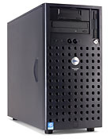
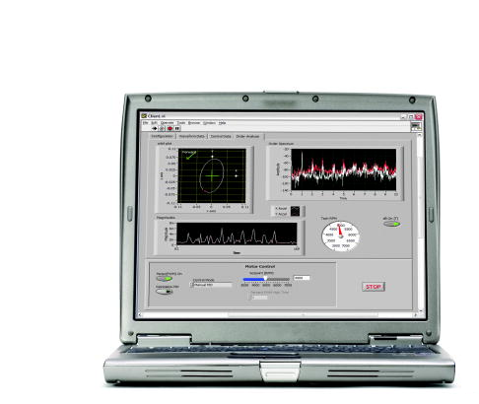
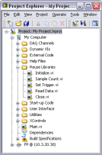
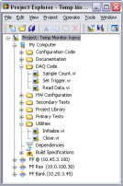
Source Code Control – Team-Based Development
Server stores all revisions of files
Project files
VIs
LLBs
Documents
Each developer can check copies of files in and out as needed
Notes:
Source Code Control – Team-Based Development
Creating large applications requires a team-based development strategy. Using a source code control system assists the team during development. A centralized server stores the source code control repository. Because the source code control system is designed to handle many different types of files, you can easily store all project related files in the source code control system. Creating backups of the source code control system repository guarantees that the time spent developing the code is not lost due to a data disaster.
With a source code control system, each developer can place the project files on their own system to develop the application. The source code control system guarantees that only one person is editing and modifying a file at any one time. After the developer finishes editing the file, she can check the file back into the source code control system and make the file available to the rest of the development team. At National Instruments, source code control is essential to the development of many products. Because National Instruments is a global company with research and development teams in many different countries, by using source code control, multi-disciplinary teams can develop products even though the teams are located in different time zones.

Slide 6
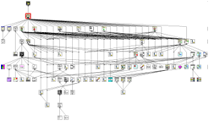
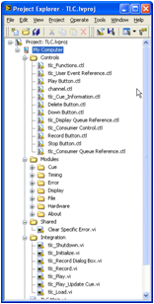
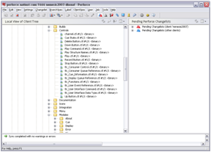
Source Code Control – Consistent Hierarchy
VI Hierarchy
Project Explorer
Source Code
Control
Notes:
Source Code Control – Consistent Hierarchy
It is a good development practice to match the Project Explorer hierarchy with the VI hierarchy used in the application. This is not always possible, especially when developing reusable components for the application. But, try to maintain synchronization of the Project Explorer hierarchy with the source code control hierarchy. This is the best way to keep track of the development in the application.

Slide 7
Source Code Control – Branch and Merge
Branch—Split from the main development line to create a new version of the code
Notes:
Source Code Control – Branch and Merge
Create a branch from the main code development to create a new version of the code. Often developers are interested in trying a new strategy with their code, or the project may evolve into a new version. By creating a branch off the main code line, the code can evolve without affecting the main code line. After the team has tested, verified, and approved the branch code, you can integrate it back into the main code line. The best strategy for source code control reserves the main code line for the most stable version of the code. You should only place code that has been fully tested, verified, and approved into the main line.

Slide 8
Source Code Control – Branch and Merge (continued)
Merge—Integrate the development split into the main development line
Notes:
Source Code Control – Branch and Merge (continued)
Individual branches are integrated into the main code line. The process of integrating the code is completely automated by the source code control provider and provides a means to greatly enhance the development process. The best strategy permits only the integration of tested, verified, and approved code into the main development line. If any developer synchronizes to the main development line, he is accessing a fully functioning version of the software.

Slide 9
Exercise 3-2: Source Code Control
Install and configure a source code control system with LabVIEW to improve the configuration management of a project and learn common techniques of using a source code control system.

